Slide 1

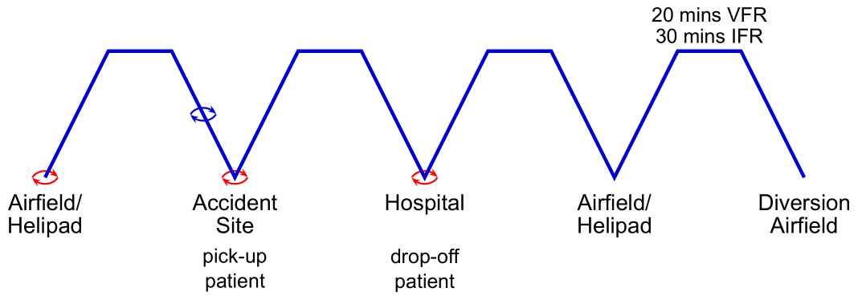
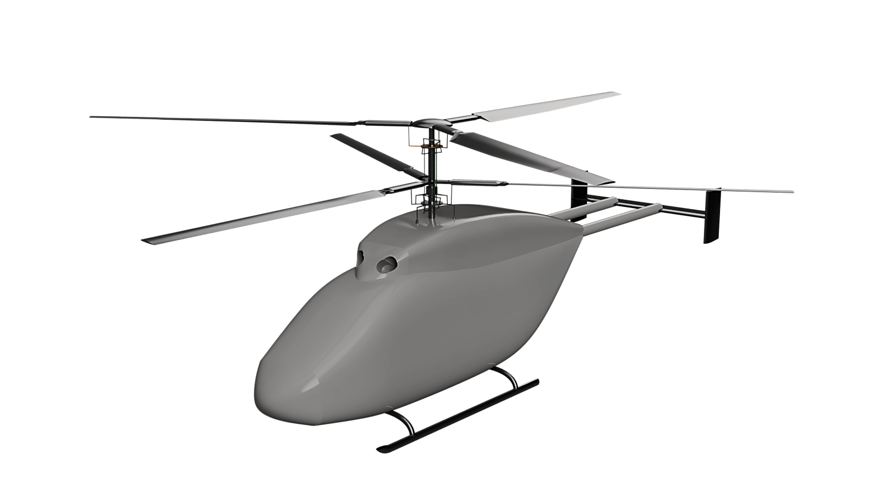
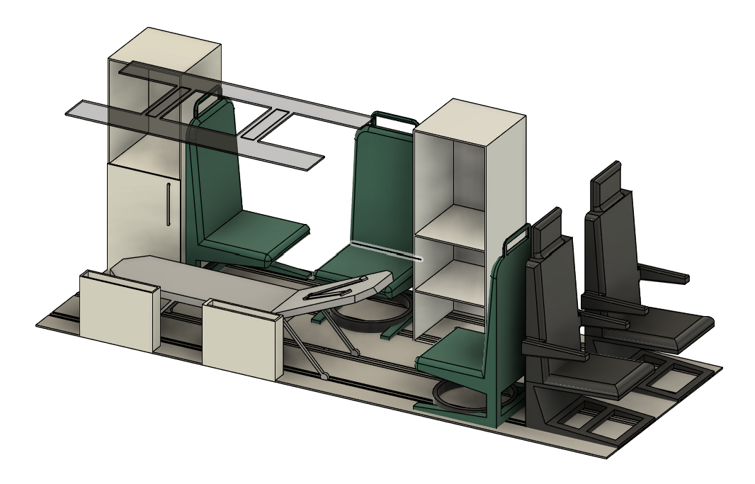
Coaxial Helicopter Design for Emergency Medical Services (HEMS)
Design Mission Profile
W₀ = 438,591kg
A helicopter designed from the ground up to save lives.
On average,
HEMS attends 126 patients
a day across the UK.
In an emergency, every second counts. That’s why HALO
is design for best-in-class performance in the light twin category. Certified under CS-29, our design aims to minimise time to the patient with an innovative design.
1524 m (5000 ft)
72 m/s (140 kts)
MTOW
3500kg
 | Type | HTS900
 | Max power (kW) | 1334
 | SFC (g/kWH) | 319.45
 | Maximum torque (Nm) | 2016
 | Fuel flow rate (kg/hr) | 153
 | Transmission loss | 7.8%
 | Transmission stages | 3
 | Reduction ratio | 15.82
 | MTOW (kg) | 3500
 | Cabin volume (m³) | 5.72
 | Fuel mass (kg) | 700
 | Max pax | 6
 | Skin material | QI CFRP
 | Skin thickness (mm) | 2
 | Frame material | Al 7075
 | Heavy frames | 2
 | Upper
 |  | Upper | Lower
 | Rotor radius (m) | 5.72
 | Aspect ratio | 19.6 | 12.6
 | Root chord (m) | 0.265 | 0.416
 | Root aerofoil | RC(4)-10
 | Tip chord (m) | 0.265
 | Tip aerofoil | RC(6)-08
 | Twist (°) | -11 | -6
 | N_{B} | 3
 | Root cutout | 20%
 | Operating RPM | 430
 | Root material | UD CFRP + polyetherimide
 | Flex beam material | UD CFRP
 | Torque tube | 17-4PH Steel
Engine
Cabin
Rotors
Structural Design
Flight and Medical systems
Through the use of composites, the weight of HALO is minimised.
A semi-monocoque layout was used, with metallic alloy frames/longerons for simplified manufacturing and CFRP skin.
CFRP was used for the rotor blades and tail as well. Aluminium alloy skids were selected over wheels for landing gear, due to their flexibility in landing on all types of terrain.
Onboard systems are designed for maximum safety whilst minimising
mass and delivering value for customers. Redundancy is present in all flight and patient critical subsystems.
Modular, fully digital avionics
enable safer flight in any
weather, day or night,
incorporating systems
such as HTAWS, NVIS,
NavFLIR and HUMS.
Cabin layout was
done with regards
to existing EMS
vehicles, with pro-
vision for critical
care equipment such as ECMO capability, prehospital analgesia, REBOA and other lifesaving procedures for the most urgent patients. Flexibility was maintained for other missions such as VIP transport or policing operations.
 | Boom length (m) | 0.2
 | Aerofoil | NACA 0015
 | chord length (m) | 0.6
 | Thickness (m) | 0.09
 | HTP width (m) | 3
 | VTP width (m) | 2
 | Empennage material | UD CFRP + Al 7075
Empennage
Aerodynamic Design
The first civilian coaxial design since the 1990s, HALO bring new technology to old ideas.
With 2 hingeless 3-bladed rotors providing lift, HALO minimises rotor size and does away with the need for a tail rotor. Torque balance analysis was used to optimise blade twist and taper, maximising thrust and lift whilst minimising profile drag.
An active flow control system is also implemented to reduce drag by up to 10%. The fuselage geometry was optimised through iterative modelling using CFD whilst a H-tail layout minimises airframe size and allows control at high speed.
HALO
Cabin layout in
medical configuration
HALO CAD model
Optimum performance
 | Ceiling (m) | Hover Ceiling OGE (m) | Range (km) | Endurance (hrs) | Max speed (m/s)
No payload | 12980 | 8500 | 1149 | 8.3 | 87.3
Max payload | 10850 | 6040 | 1018 | 6.6 | 12.0
Control System Design
A linearized state-space model was generated following trim analysis of HALO with a plug-in physical model, enabling plug-and-play submodel updates without altering core functions.
The helicopter’s static and dynamic stability was then evaluated to verify compliance with CS-29 certification requirements
A cascade-structured, PID-based SAS and autopilot were developed: the altitude and airspeed loops, together with yaw- and roll-rate dampers, were gain-scheduled and tuned via a simplified mission profile to meet ADS-33E-PRF Level-1 handling criteria
Engine Selection
Mission Profile
Altitude (ft/m) | Speed (KTAS/ms⁻¹) | Payload (kg) | Cruise time (min) | Cruise range (nm/km) | Hover time (min) | Contingency cruise (min)
5000/1524 | 140/72 | 886 | 90 | 240/440 | 25 | 30
The Honeywell HTS900 was selected for HALO, delivering excellent performance with an excess of power for auxiliary systems.
A custom transmission minimises losses.

